Slide 1
A Study on Topology in CN
SAILESH PANDEY(1NT18CS201)
MANAN VANAWAT(1NT18CS091)

Slide 2
Introduction
Network topology is the arrangement of the nodes or links of a communication network.
It describes the arrangement of various types of telecommunication networks.
It is totally based on Graph Theory.
- In mathematics , Graph Theory is used to model the pairwise relationship between objects.
- The graph is made up of vertices connected by edges. The vertices resemble the nodes and the edges resemble the links between the nodes.

Slide 3
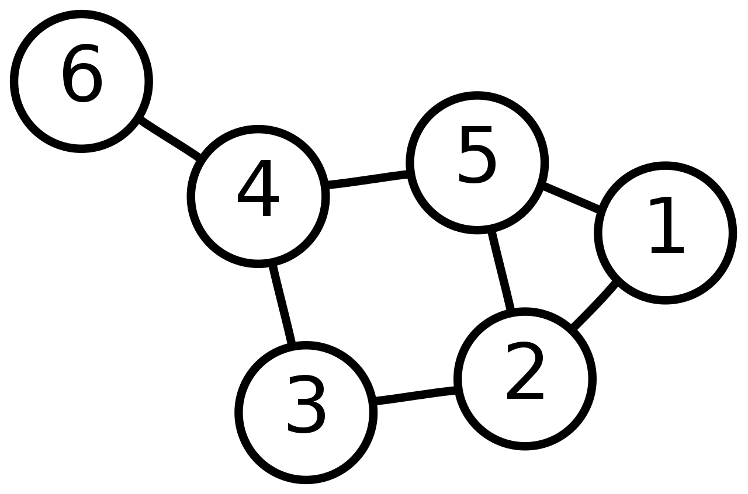

Slide 4
Computer Networks
Computer networks have developed and obtained huge achievements in the last two decades.
In particular, as a typical representative of computer network Internet is a global, open integration, that anyone can use multiple network applications across heterogeneous networks.
A computer network is a group of computers that use a set of common communication protocols over digital interconnections for the purpose of sharing resources located on or provided by the network nodes.
The nodes can be classified by many means as personal computers, sever computers, networking hardware, or any other general purpose hosts.

Slide 5
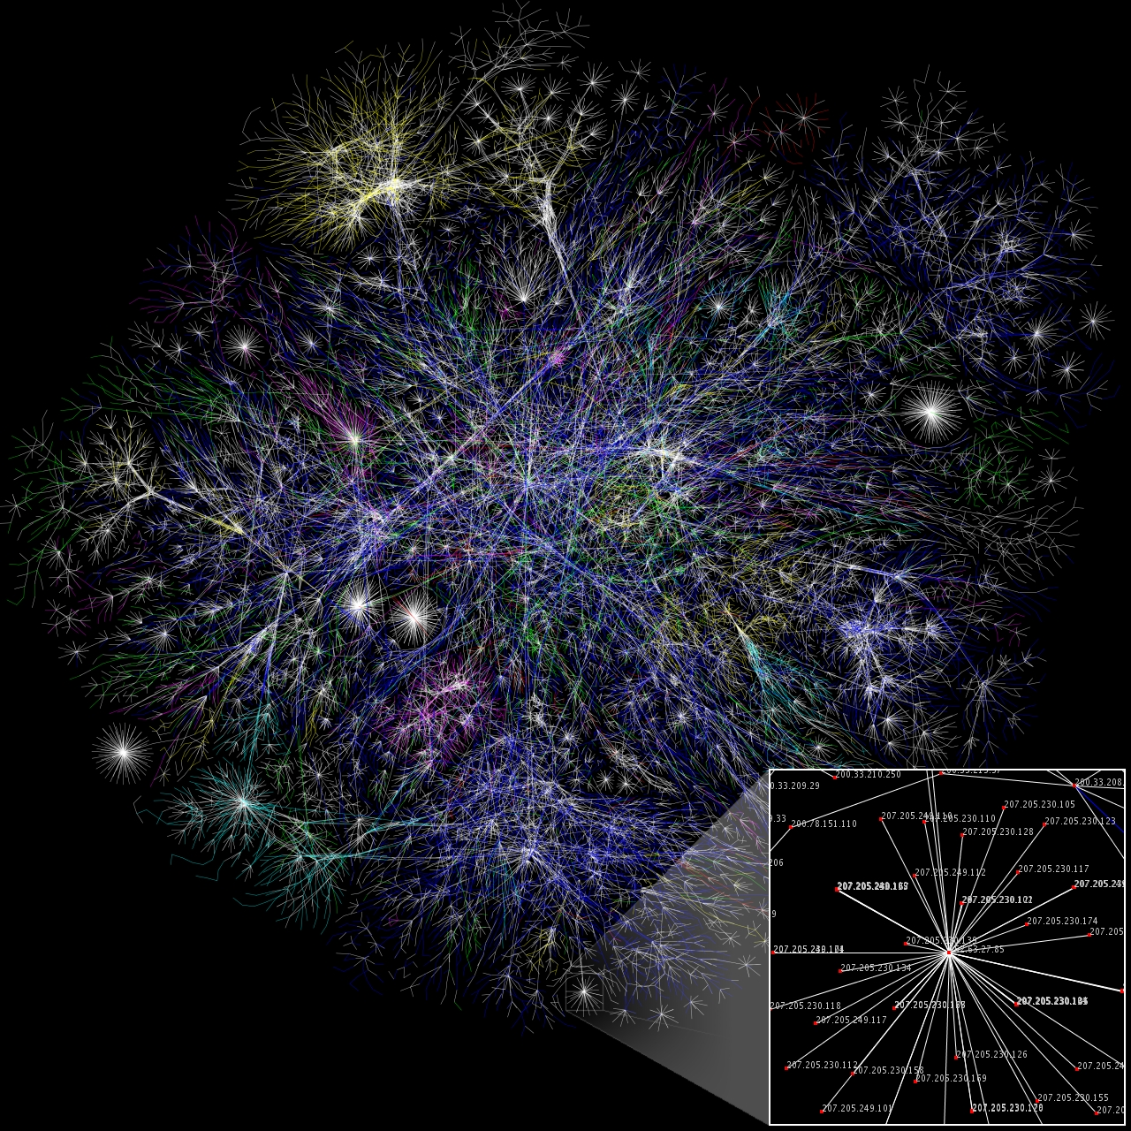

Slide 6
Network Structure
The famous network structure is OSI model which is a product of the open system interconnection, effort at International Organization for Standardization.
Layers
Physical Layer
Data Link Layer
Network Layer
Transport Layer
Session Layer
Presentation Layer
Application Layer

Slide 7
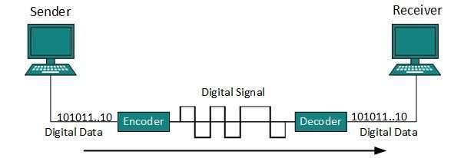
The Physical Layer
Used for the electrical and the physical specification for the devices.
Supplies an electrical, mechanical and procedural interface to the transmission data
Cables connect different devices to each other, allowing data to be transmitted over them.
Copper cables(twisted pair cables)(cat5,cat5e,cat6)
Fiber Cables

Slide 8
The Physical Layer(continued..)
Almost about 10 Billion zeros and ones cross the network cables every second.
Overall The Physical Layer defines the relationship between a device and a transmission data, including voltages, hubs, adapters and so on.
The physical layer supplies the transmission of data across the network.

Slide 9
The Data Link Layer
The Data Link Layer defines the functional and the procedural regards of data network entities.
It also helps to detect and correct the error as far as possible.
This was originally intended for point-to-point and point-to-multipoint. But now it is used for broadcast in multi-access data.
Its main task is to produce frame boundary of data.

Slide 10
The Network Layer
The network layer supplies network routing functions and reports the error.
Routers work at this layer.
It operates subnet and determines the routing strategies.
It helps in host addressing.
It routes the signal through different channels to the other end and acts as a network controller.

Slide 11
The Transport Layer
The transport layer receives reliable data from the upper layer and transfer data between end users
It also allows traffic to be directed to specific network applications
The Session Layer
This layer helps in building a connection.
This layer provides a proper user interface to the network where the user negotiates to build the connection.
It is mainly utilized for transfer layer.
Its major work is to transfer data from the other application.

Slide 12
The Presentation Layer
It builds contact among all the application layers so that the layer above may utilize different syntax and semantic if the presentation services provide a mapping between them.
Responsible for making sure that the uncapsulated application layer data is able to be understood by the application in the question.
The Application Layer
It is the layer that is closest to the end user in the OSI layer.
With software application , both, the OSI application layer and user interacts directly.

Slide 13
Internet Topology

Slide 14
Topology
Network topology is the arrangement of the links and nodes of any communication network.
It may be disputed physically or logically.
Types:
1.Bus topology
2.Star topology
3.Ring topology
4.Mesh topology
5.Tree topology
6.Daisy chain topology
7.Hybrid topology
8.Point-to-point topology

Slide 15
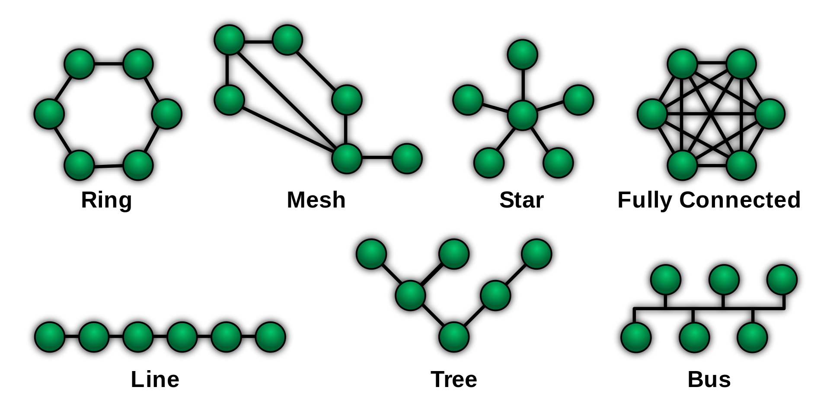

Slide 16
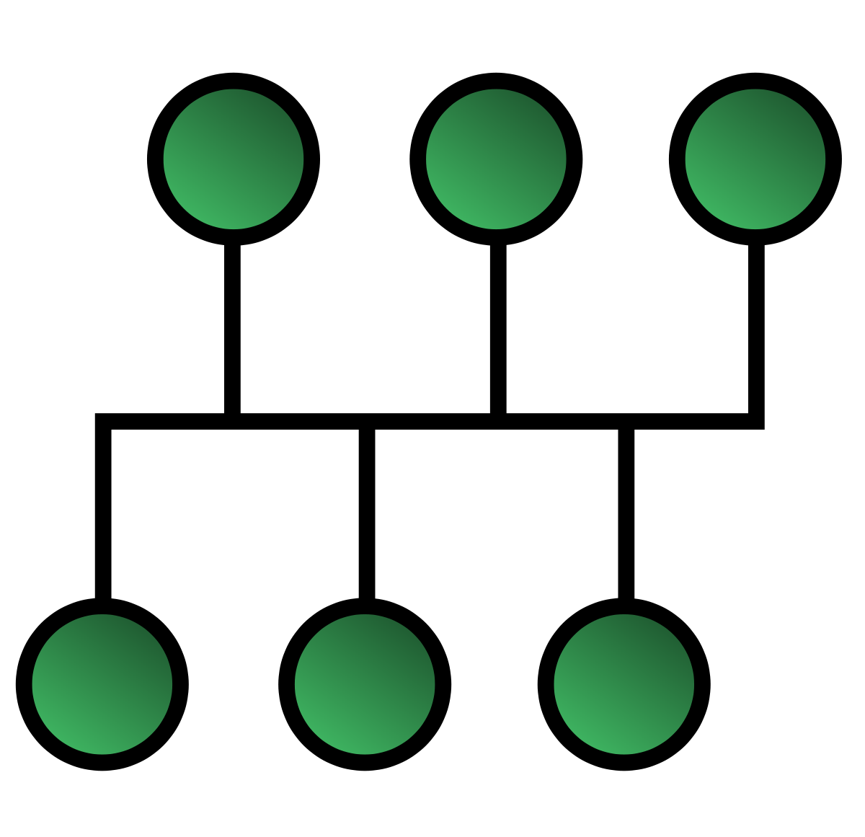
1.Bus topology
A Bus Topology is a network topology in which nodes are connected to a common half-duplex link called bus.
Every station will receive the network traffic, and the traffic generated by each station has equal transmission priority.
In order for the nodes to share the bus, they use a medium access control technology like CSMA or any bus master.

Slide 17
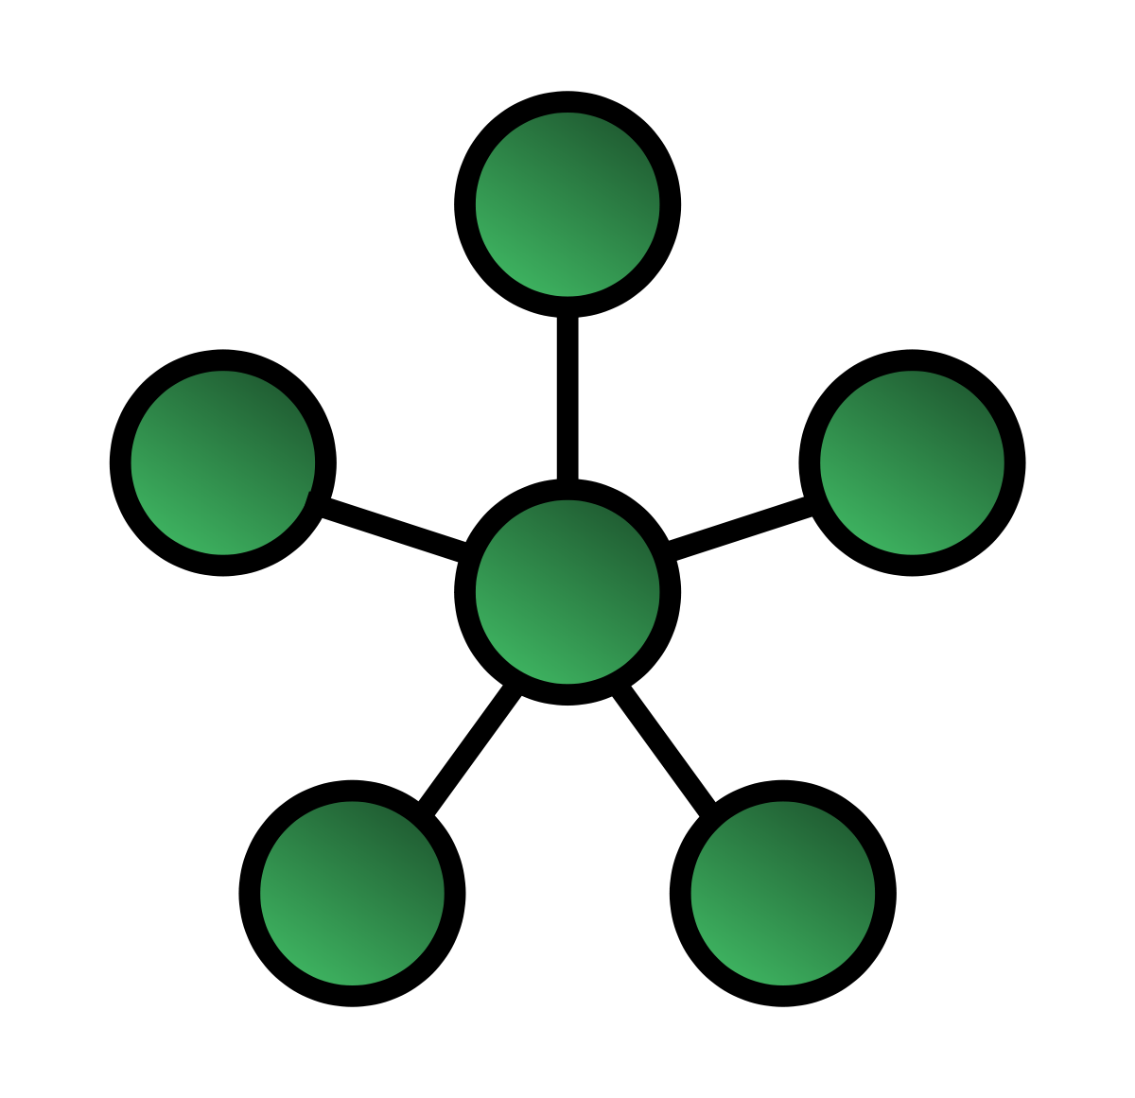
2.Star topology
This is the most common and the mosty used network topology.
Every node connects to a central network device like HUB, switch or any other computer.
The central device acts as a server and other peripheral devices act as clients.
The central node is the core part of the network.
It makes administrators easy to add another device to the network.

Slide 18
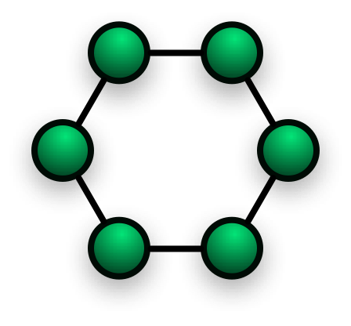
3.Ring topology
A ring topology is a network topology in which each node connects to exactly two other nodes respectively.
Data travels from nodes to nodes.
Each nodes handle every packets.
The rings can be unidirectional or bi-directional.
The Bidirectional can be helpful as it will still work if some nodes break down.

Slide 19
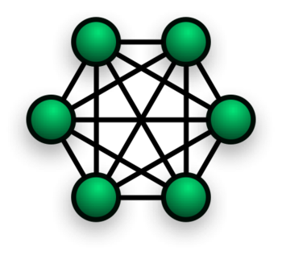
4.Mesh topology
Each device is connected to every other device on the network.
It is a dedicated point-to-point link.
Lets say we have n-devices in the network, each device must be connected with (n-1) device of the network.
Number of links in the mesh topology of n devices will be n(n-1)/2.

Slide 20
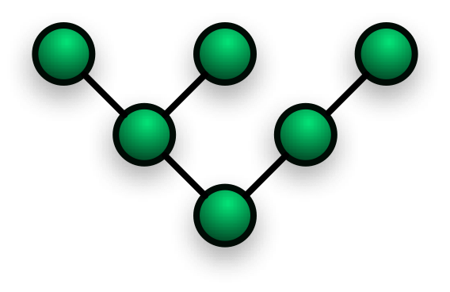
5.Tree topology
Tree topology has its roots derived from bus and star topology.
It is not used widely but still used in the cases when scalability or hierarchical communication setup is needed between two networks.
Other hierarchical networks are not affected if one of them gets damaged.
The maintainance and fault finding is easier.

Slide 21
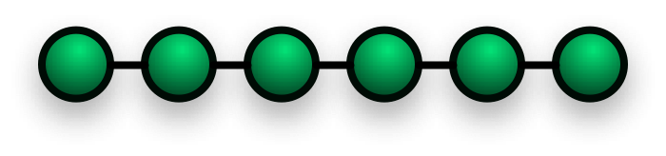
6.Daisy chain topology
The main advantage of daisy chain is easy to add more computers or servers into a network by connecting each computer in series to the next.
Data will be intended for a computer partway down the line, each system bounces it along in sequence until it reaches the destination.

Slide 22
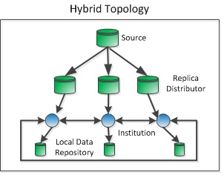
7.Hybrid topology
Hybrid network is a combination of two or more
topologies mentioned above.
By combination, each network does not exhibit one of the standard topologies.
Like, a mesh network connected to a mesh
network is still a mesh network topology.
However, a hybrid topology is always produced when two different basic network topologies are connected.

Slide 23
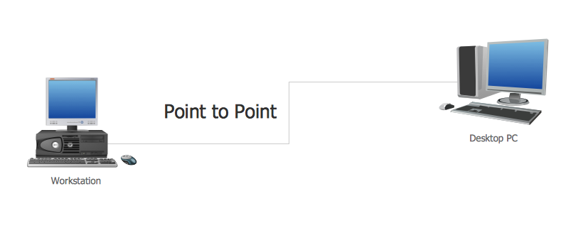
8. Point-to-Point Topology
This structure is called P2P(Point-to-Point). This is a famous network structure.
It defines permanent links between two endpoints.
The value of an on-demand P2P connection is positive proportional to the number of potential pairs of network nodes.

Slide 24
References
Inc, S, (2002). Networking Complete. Third Edition. San Francisco: (Sybex)
Wikipedia - Computer network – Wikipedia
ATIS committee PRQC. "network topology". ATIS Telecom Glossary 2007.
Alliance for Telecommunications Industry Solutions
4. A Study on Topology in Computer Network Qing Liu, Qiuping Liu

Slide 25


